Slide 1
2. Getting started

Slide 2
2.1 Insertion sort
Example: Sorting problem
Input: A sequence of n numbers ⟨a₁, a₂, …, a_{n}⟩
Output: A permutation ⟨a₁’, a₂’, …, a_{n}’⟩ of the input sequence such that s.t. a₁’ ≤ a₂’ ≤ ··· ≤ a_{n}’ .
The numbers that we wish to sort are known as the keys. Usually a data set X has data x with the form x = ⟨k, x’⟩ where k is the key and x’ is rest of the data.

Slide 3
Pseudocode of insertion sort
INSERTION-SORT(A)
1 for j ←2 to length[A]
2 do key ← A[j]
3 /∗ Insert A[j] into the sorted sequence A[1..j-1] */
4 i ← j − 1
5 while i > 0 and A[i] > key
6 do A[i + 1] ← A[i]
7 i ← i − 1
8 A[i +1] ← key
A[1]
⋅⋅⋅
⋅⋅⋅
A[j-1]
A[j]
⋅⋅⋅
⋅⋅⋅

Slide 4
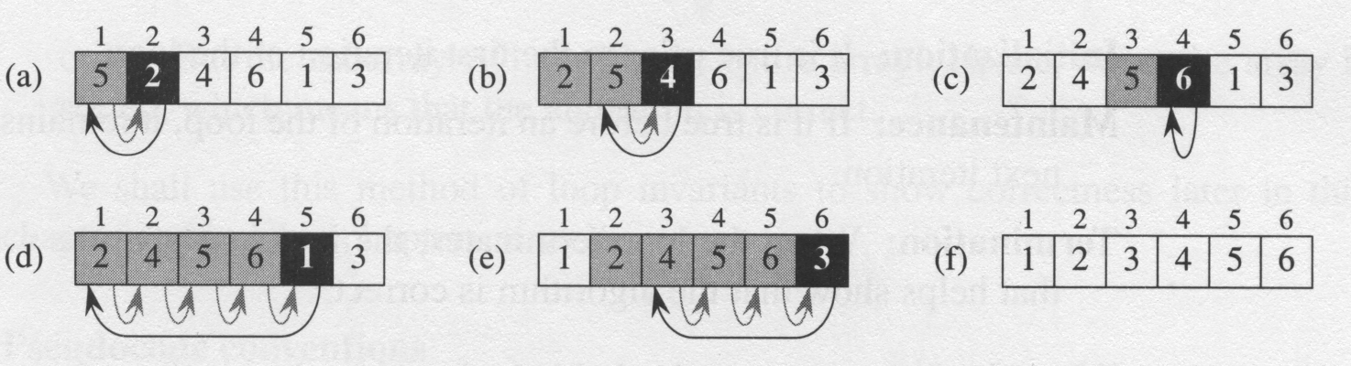
The operation of INSERTION-SORT
The operation of INSERTION-SORT on the array A = ⟨5, 2, 4, 6, 1, 3⟩. (a)-(e) The iteration of the for-loop. (f) The final sorted array.
The black one: the joining element,
The gray ones: compared elements.

Slide 5
Properties of INSERTION-SORT
Loop invariant :
At the start of each iteration of the for-loop, the subarray A[1.. j-1] consists of the elements originally in A[1.. j-1] but in sorted order.
This property is used to prove the algorithm is correct.
Sorted in place :
The numbers are rearranged within the array A, with at most a constant number of them sorted outside the array at any time.

Slide 6
2.2 Analyzing algorithms
Analyzing an algorithm has come to mean predicting the resources that the algorithm requires.
Resources: memory, communication, bandwidth, logic gate, time (complexity).
Assumption: one processor in a Turing machine (or an equivalent one).
(We shall have occasions to investigate models for parallel computers and digital hardware.)

Slide 7
2.2 Analyzing algorithms (cont.)
The running time (complexity) of an algorithm on a particular input is the number of primitive operations or “steps” executed. It is convenient to define the notion of step so that it is as machine-independent as possible.
The best notion for input size depends on the problem being studied.
E.g., the problem to check whether or not a number is a prime number: the input is usually measured in bits.
E.g., for graph algorithms, we describe complexity relative to the numbers of vertices and edges in the graph.

Slide 8
INSERTION-SORT(A) cost times
1 for j ← 2 to length[A]
2 do key ← A[j]
3 /∗ Insert A[j] into the
sorted sequence A[1.. j -1] */
4 i ← j − 1
5 while i > 0 and A[i] > key
6 do A[i +1] ← A[i]
7 i ← i − 1
8 A[i +1] ← key
t_{j} : the number of times the while loop test in line 5 is executed for the value of A[j].
c₁ n
c₂ n–1
0
c₄ n–1
c₅
c₆
c₇
c₈ n–1

Slide 9
The running time
The running time of the best-case:
t_{j} = 1 for j = 2, 3, …, n : T(n) is a linear function on n.

Slide 10
The running time (cont.)
The running time of the worst-case & the average-case:
t_{j} = j for j = 2, 3, …, n : quadratic function on n.

Slide 11
Worst-case and average-case analysis
Usually, we concentrate on finding only the worst-case running time
Reason:
It is an upper bound on the running time,
The worst case occurs fair often,
The average case is often as bad as the worst case, for example, the insertion sort.
Sometime the analysis is easier.

Slide 12
Order of growth
In some particular cases, we shall be interested in average-case, or expected running time of an algorithm.
It is the rate of growth, or order of growth, of the running time that really interests us.

Slide 13
2.3 Designing algorithms
There are many ways to design algorithms:
Incremental approach: insertion sort
Divide-and-conquer: merge sort
recursive:
divide
conquer
combine

Slide 14
Pseudocode of MERGE()
MERGE(A, p, q, r)
1 n₁ ← q – p + 1
2 n₂ ← r – q
3 create arrays L[ 1 .. n₁ + 1 ] and R[ 1 .. n₂ + 1 ]
4 for i ← 1 to n₁
5 do L[ i ] ←A[ p + i – 1 ]
6 for j ← 1 to n₂
7 do R[ j ] ←A[ q + j ]
8 L[n₁ + 1] ← ∞
9 R[n₂ + 1] ← ∞

Slide 15
Pseudocode of MERGE() (cont.)
10 i ←1
11 j ←1
12 for k ← p to r
13 do if L[ i ] ≤ R[ j ]
14 then A[ k ] ← L[ i ]
15 i ← i + 1
16 else A[ k ] ← R[ j ]
17 j ← j + 1

Slide 16
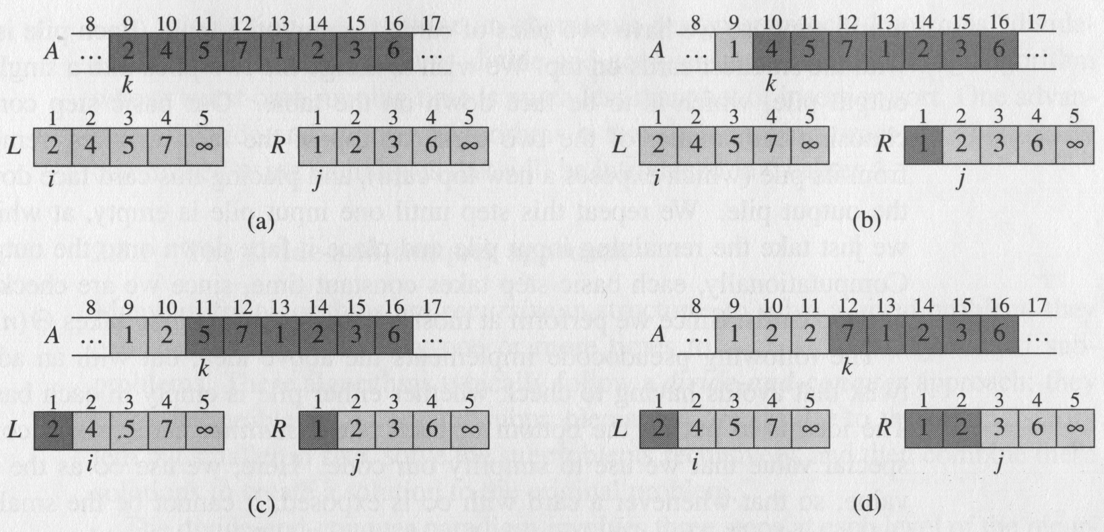
An example of merge sort
The operation of lines 10-17 (the 2nd part) in the call MERGE(A, 9, 12, 16)

Slide 17
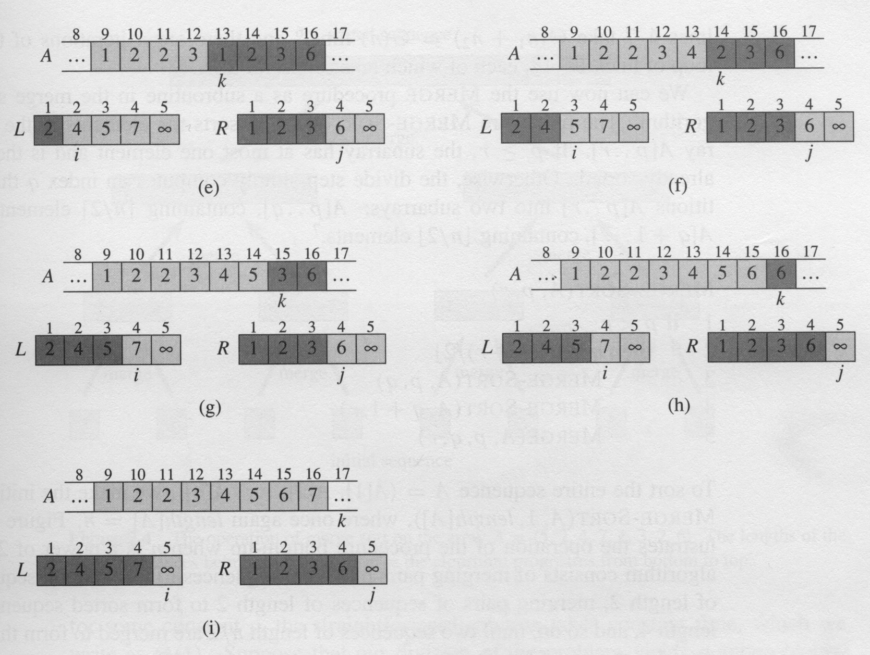

Slide 18
Pseudocode of merge sort
MERGE-SORT(A, p, r)
1 if p < r
2 then q ← ⎣(p+r)/2⎦
3 MERGE-SORT(A, p, q)
4 MERGE-SORT(A, q+1, r)
5 MERGE(A, p, q, r)

Slide 19
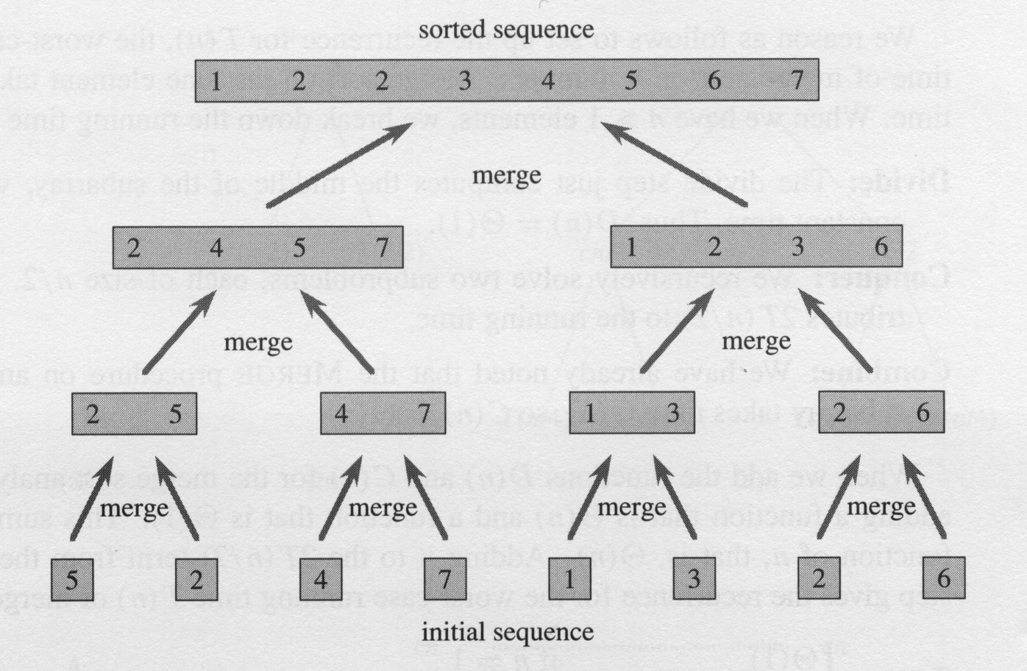
An example of merge sort (cont.)
The operation of merge sort on the array
A = ⟨ 5, 2, 4, 7, 1, 3, 2, 6 ⟩

Slide 20
Analysis of divide-and-conquer algorithms
Analyzing divide-and-conquer algorithms
Analysis of merge sort

Slide 21
Analysis of merge sort
where the constant c represents the time require to solve problems of size 1 as well as the time per array element of the divide and combine steps.

Slide 22
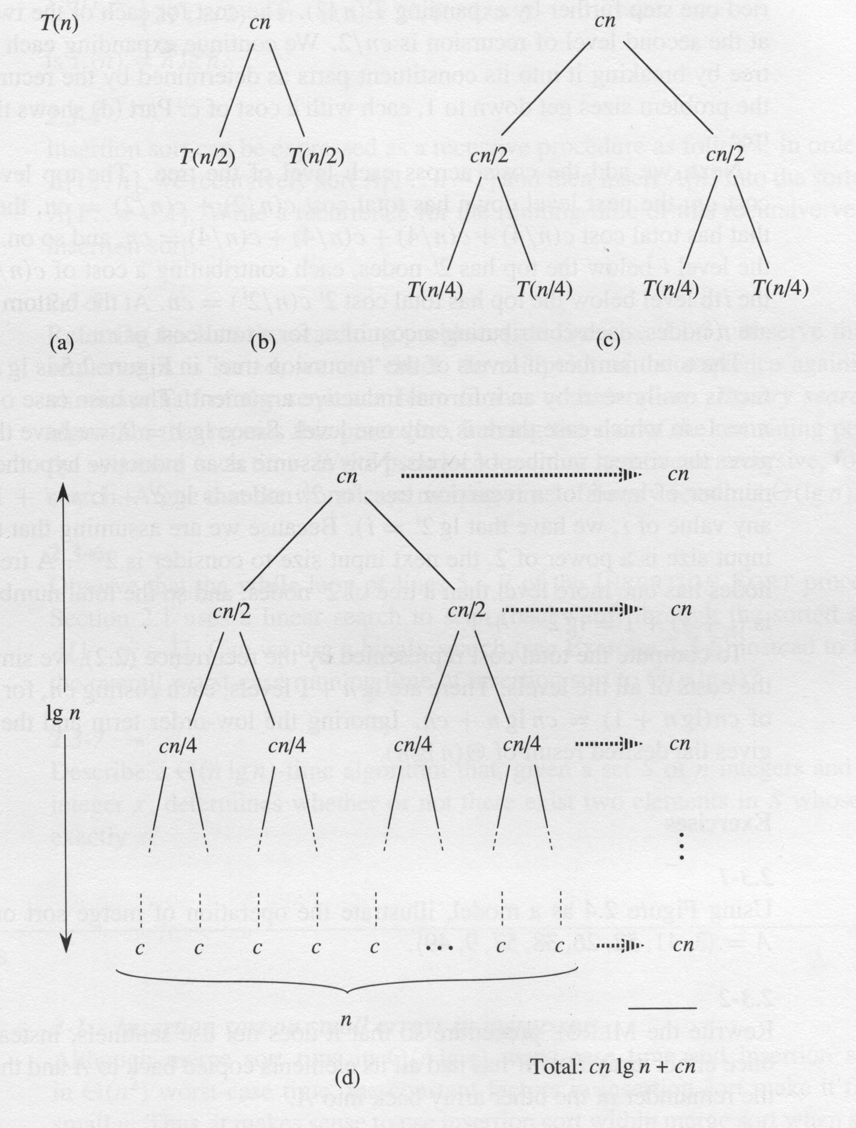

Slide 23
Merge sort outperforms insertion sort!
(in the average and worst cases)

